Slide 1

Hybrid Electronic Order Submission (HEOS) System
Requirement and Software Mock-up

Slide 2

Scope for the Software
Build a web based workflow system for Hybrid customers to submit material pickup details in a weekly or monthly format and such request is then routed automatically to the Suppliers for acknowledgement while the Master Record by the Customer is moved through stage gates of action with necessary alerts and reports.
See following slides for this defined workflow

Slide 3
Roles for the Software
Role | Description | Action
Hybrid Admin | A person responsible for creating a new account for customer, partner or Hy-Brid user | Full Rights to Add/Modify/Delete accounts, See consolidated schedules, Historical, Run Reports
Customer | A customer with an established relationship and user id can submit pick-up order or modify supplier details | Controlled Rights – change password, create/modify pick up orders within a defined timeline, run historical and scheduled reports on the pickup status, receives confirmation on pick-up
Supplier Partner | Supplier Partner with active user id and password | Controlled Rights – change password, See submitted orders (their orders only), Run scheduled and historical reports
Common Features: Email alerts on submission, order received, order completed, password change.
Optional: Copies of any query report to Hybrid Management

Slide 4
Software Features
Internet based login via Hybrid website
Form submission by customer as auto insert (either completed by customer or by Hybrid employee)
Confirmation of order submission to customer
When saved of customer order – Auto alert to Suppliers with acknowledgement of the order for pick-up
Adjustable Dashboard View for Hybrid team to see status
Historical and Scheduled Reports – On-demand or Scheduled
Audit history (Login Trace, Login Exemptions, Reports and Queries, Password changes)

Slide 5
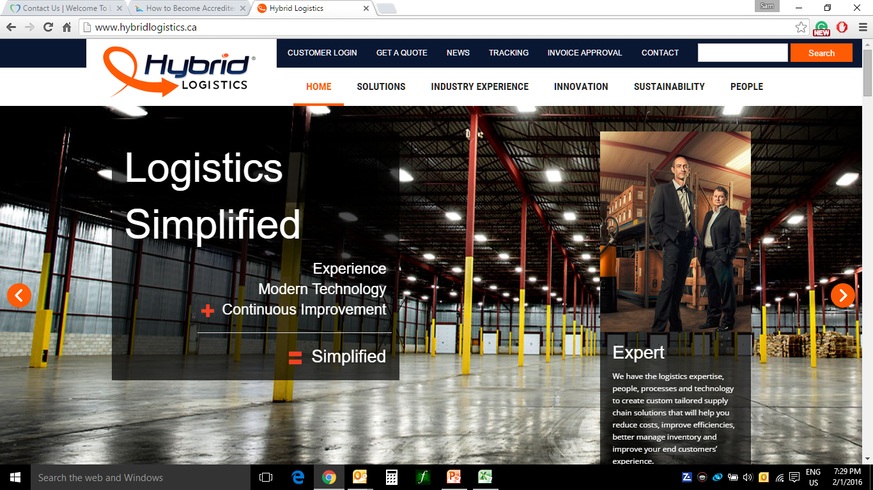
HEOS – Entry Page
LOGIN
Note: Hybrid to change Customer Login to LOGIN

Slide 6
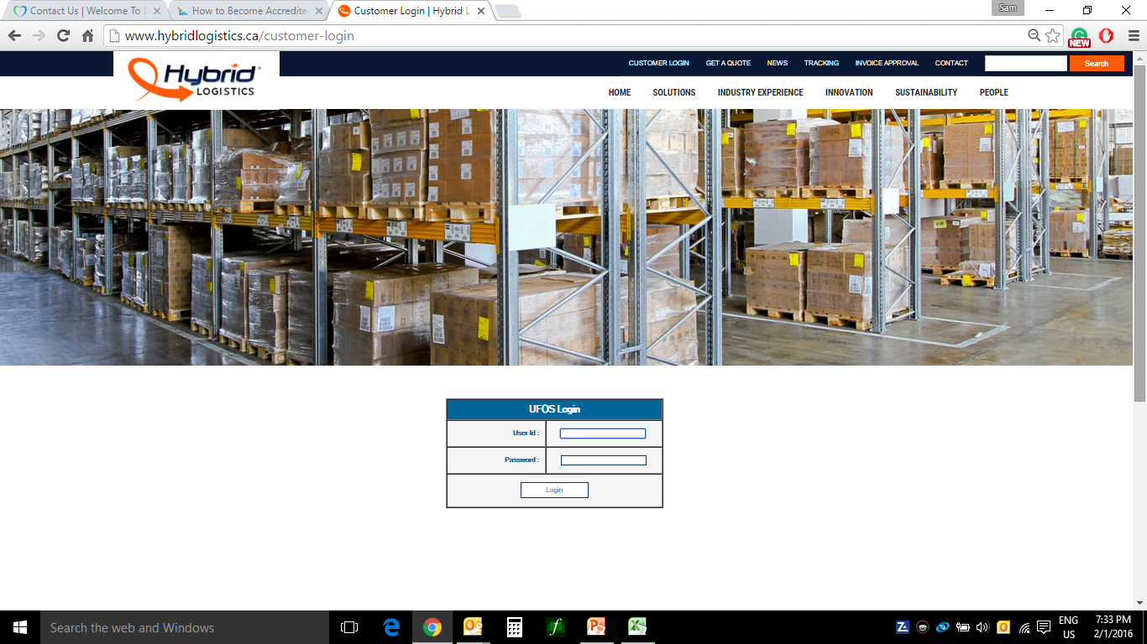
Screen Mock-up – HEOS Login Page
HEOS Login
Note: It is possible to have the HEOS Login at the home page

Slide 7
Screen Mock-up – HEOS Hybrid Page
Once the Supplier accepted with the delivery details, the system will hyper link the supplier to show the following details:
Total Skid Count: Dimensions: Freight Class: stackable?: Gross weight
SEE SUPPLIER ACCEPTANCE SLIDE FOR DETAILS
Welcome to Hybrid HEOS System
User: Ali Sheikh, Hybrid
Last Login: Feb 1, 2016 09:45
Account Maintenance
Scheduled Events – Week 1/11/2016 (Generated 1/8/2016 11:48)
Customer | Supplier - Canada | Plant | Pick-Up | Pick Up Day | Arrival Day | Stack | Comments | Supplier Status | Assigned to | Date | By | Status (Select)
Magna | Co-Ex-Tec to H&L | Newmarket | Yes | Tues | Thurs | Yes | 02/10/16 10:00 SHEIKHA: Found issues with qty 02/10/16 13:15 SZENTEC: Problem corrected | ACCEPTED
Magna | Co-Ex-Tec to H&L | Newmarket | Yes | Tues | Thurs | Yes | 02/10/16 10:00 SSINGHH: Missing pickup – Manual submission | PENDING
Magna | Etbo Tool & Die | Newmarket | Yes | Tues | Wed | Yes | -- | PENDING
Magna | Vision Coaters Canada | Newmarket | Yes | Daily | Daily | Yes | -- | PENDING
Guys:
As discussed, lets hide the No pickup however add a hyperlink for Hybrid to go to the Order Submission (see slides further below)
Click to Enter an Order
Canada (Selected) | US | Mexico | Query | Save (when modified)
Note: The above you see in Blue column from the customer and the Orange column is Hybrid activities. Any Hybrid change requires ‘Save’. For ‘Query’ and ‘Account Maintenance’ – see separate slides

Slide 8
Screen Mock-up – HEOS Hybrid Manual Entry
Welcome to Hybrid HEOS System
User: Ali Sheikh, Hybrid
Last Login: Feb 1, 2016 09:45
Welcome Ali {Date/Time}
Manual Order Entry
Customer | Supplier | Plant | Pick-Up | Pick Up Day | Arrival Day | Stack | Comments | Supplier Status | Assigned to | Date | By | Status (Select)
Magna | Select Supplier | Select Plant | Yes | Tues | Thurs | Yes |  | PENDING
Magna | Select Supplier | Select Plant | Yes | Tues | Thurs | Yes |  | PENDING
Add More Lines of Order
Canada | US | Mexico |  | Save (Once verified)
Note: The above you see in Blue column from the customer and the Orange column is Hybrid activities. Any changes to the submission will require a save. Once the customer SAVEs then the account will be locked for them. Only Hybrid can make changes to any client SAVEd submission.

Slide 9

Screen Mock-up – HEOS Account Maintenance
Welcome to Hybrid HEOS System
User: Ali Sheikh, Hybrid
Last Login: Feb 1, 2016 09:45
Account Maintenance
Account Maintenance
Manage User
New User
Update User
User Password
User Delete
Manage Partner
New Partner
Update Partner
Partner Password
Partner Delete
Canada | US | Mexico | Query | Current

Slide 10
Screen Mock-up – HEOS User Creation
Welcome to Hybrid HEOS System
User: Ali Sheikh, Hybrid
Last Login: Feb 1, 2016 09:45
Account Maintenance
Account Maintenance – Manage User
Details |  | Comments
User ID |  | Last Name/First Initial (e.g. SHEIKHA)
Full Name
Company | SELECT COMPANY FROM DROP DOWN | You need a Customer or Supplier in the system to create a USERID. If new customer or supplier enter details as such
Email Address |  | This is the email be used for password reset/order confirmation etc.
Password |  | 12 characters – 1 Cap, 1 Numeric, 1 Special Character – NO PREVIOUS PASSWORDS
 | DELETE | SAVE |  | HOME
For USERID password reset, you will simply enter the person’s USERID and reset password. When a password is reset, an email will be sent to user with the new password. To update user details such as email address – same screen. To DELETE a user, simply enter USERID and once the USERID is confirmed, click DELETE.

Slide 11
Screen Mock-up – HEOS Partner Creation
Welcome to Hybrid HEOS System User: Ali Sheikh, Hybrid
Last Login: Feb 1, 2016 09:45
Account Maintenance
Account Maintenance – Manage Partner
Details |  | Comments
Select Supplier Company
Contact Full Name
Select USERID or IDs |  | Last Name/First Initial (e.g. SHEIKHA)
Contact Phone No |  | Contact Phone No
Email Address |  | This is the email be used for password reset/order confirmation etc.
Password |  | 12 characters – 1 Cap, 1 Numeric, 1 Special Character – NO PREVIOUS PASSWORDS
Alternate Contact |  | Enter secondary contact and phone number
 | DELETE | SAVE |  | HOME
For Contact USERID password reset, you will simply enter the Contact USERID and reset password. When a password is reset, an email will be sent to user with the new password. To update user details such as email address – same screen. To DELETE a user, simply enter USERID and once the USERID is confirmed, click DELETE.

Slide 12
Screen Mock-up – HEOS Customer Page
Guys: When there is a manual entry made by supplier or Hybrid, the customer can cancel this order. So the choices for all entry is PENDING (Default), ACCEPTED, CANCEL. Only Customer or Hybrid can CANCEL an order.
Dhammika: This brings an interesting challenge – what we do when an order gets cancelled… HEOS removes the order from the list and send alert?
Welcome to Hybrid HEOS System
User: Cristina Szente, Magna
Last Login: Jan 31, 2016 09:45
Welcome Cristina {Date/Time}
Pending Approval
Customer | Supplier - Canada | Plant | Pick-Up | Pick Up Day | Arrival Day | Stack | Comments | Supplier Status | Assigned to | Date | By | Status (Select)
Magna | Co-Ex-Tec to H&L | Newmarket | Yes | Tues | Thurs | Yes | 02/10/16 10:00 SHEIKHA: Found issues with qty 02/10/16 13:15 SZENTEC: Problem corrected | PENDING
Add manual Order Enter Batch Order
Canada | US | Mexico |  | Save (Once verified)
Note: The above you see in Blue column from the customer and the Orange column is Hybrid activities. Any changes to the submission will require a save. Once the customer SAVEs then the account will be locked for them. Only Hybrid can make changes to any client SAVEd submission.

Slide 13
Screen Mock-up – Customer Manual Entry Page
Welcome to Hybrid HEOS System
User: Cristina Szente, Magna
Last Login: Jan 31, 2016 09:45
Welcome Cristina {Date/Time}
Manual Order Entry
Customer | Supplier | Plant | Pick-Up | Pick Up Day | Arrival Day | Stack | Comments | Supplier Status | Assigned to | Date | By | Status (Select)
Magna | Select Supplier | Select Plant | Yes | Tues | Thurs | Yes |  | PENDING
Magna | Select Supplier | Select Plant | Yes | Tues | Thurs | Yes | 02/10/16 13:15 SZENTEC: Missed Order | PENDING
Add More Lines of Order
Canada | US | Mexico |  | Save (Once verified)
Note: The above you see in Blue column from the customer and the Orange column is Hybrid activities. Any changes to the submission will require a save. Once the customer SAVEs then the account will be locked for them. Only Hybrid can make changes to any client SAVEd submission.

Slide 14
Screen Mock-up – HEOS Customer Batch Entry Page
Welcome to Hybrid HEOS System
User: Cristina Szente, Magna
Last Login: Jan 31, 2016 09:45
Welcome Cristina {Date/Time}
Batch Entry Screen
Description | Action
File Name (File stored within the HEOS for verification) | Select
Submitted By – Auto user name | Christina Szente
Submitted Date and Time | Date and Time Stamp
Canada | US | Mexico |  | Save (Once verified)
Note: The above you see in Blue column from the customer and the Orange column is Hybrid activities. Any changes to the submission will require a save. Once the customer SAVEs then the account will be locked for them. Only Hybrid can make changes to any client SAVEd submission.

Slide 15
Screen Mock-up – HEOS Batch Entry Verification Page
Welcome to Hybrid HEOS System
User: Cristina Szente, Magna
Last Login: Jan 31, 2016 09:45
Imported Schedule
Scheduled Events – Week 1/11/2016 (Generated 1/8/2016 11:48) SHOWING YES BY CANADA
Customer | Supplier – Canada | Plant | Pick-Up | Pick Up Day | Arrival Day | Stack | Comments | Supplier Status | Assigned to | Date | By | Status (Select)
Magna | Co-Ex-Tec to H&L | Newmarket | Yes | Tues | Thurs | Yes | --
Magna | Etbo Tool & Die | Newmarket | Yes | Tues | Wed | Yes | --
Magna | Vision Coaters Canada | Newmarket | Yes | Daily | Daily | Yes | --
Show All Show all YES Show YES by Country Show all NO Show all NO by Country
Canada (Selected) | US | Mexico | Query | Save (when modified)
Note: The above you see in Blue column from the customer and the Orange column is Hybrid activities. Any changes to the submission will require a save. Once the customer SAVEs then the account will be locked for them. Only Hybrid can make changes to any client SAVEed submission.

Slide 16
Screen Mock-up – HEOS Supplier Acknowledgement Page
Welcome to Hybrid HEOS System
User: Harry Singh, Co-Ex-Tec to H&L
Last Login: Jan 30, 2016 10:45
Guys:
For any Insert Manual Entry Record ONLY the Customer (Magna) can turn that into ACCEPTED.
Until the Customer accepts the record will show as pending even though the supplier has entered DETAILS and saved.
Welcome Harry {Date/Time}
Supplier Acknowledgement – Week 1/11/2016 (Generated 1/8/2016 11:48)
Customer | Plant | Pick-Up | Pick Up Day | Arrival Day | Stack | Comments | Product | Skid Count | Dimension | Freight Class | Stackable | Weight | Status (Select)
Magna | Newmarket | Yes | Tues | Thurs | Yes | -- |  |  |  |  |  |  | PENDING
Insert Manual Entry
 |  |  | Query | Save (when modified)
Note: The above you see in Blue column from the customer and the Orange column is Hybrid activities. Any changes to the submission will require a save. Once the customer SAVEs then the account will be locked for them. Only Hybrid can make changes to any client SAVEed submission.

Slide 17
Screen Mock-up – HEOS Supplier Manual Entry Page
Guys:
For any Insert Manual Entry Record ONLY the Customer (Magna) can turn that into ACCEPTED.
Until the Customer accepts the record will show as pending even though the supplier has entered DETAILS and saved.
Please see on Hybrid Dashboard there will be two orders for Co-Ex-Tec to H&L where one was from customer and supplier accepted while the other is waiting for customer approval
In similar, all suppliers can make manual entry to submit to the customer for approval.. Means a supplier can login to HEOS and make a manual submission.
Welcome to Hybrid HEOS System
User: Harry Singh, Co-Ex-Tec to H&L
Last Login: Dec 30, 2015 10:45
Welcome Harry {Date/Time}
Supplier Acknowledgement – Week 1/11/2016 (Generated 1/8/2016 11:48) MANUAL ENTRY MODE FOR MISSED ORDER
Customer | Plant | Pick-Up | Pick Up Day | Arrival Day | Stack | Comments | Product | Skid Count | Dimension | Freight Class | Stackable | Weight | Status (Select)
Magna | Newmarket | Yes | Tues | Thurs | Yes | -- | xxx | xxx | xxx | xxx | xx | xxxx | ACCPTED
Select | Select | YES | Tues | Thurs | YES | NEW ENTRY | xxx | xxx | xxx | xxx | xx | xxxx | PENDING
Insert Manual Entry
 |  |  | Query | Save (when modified)
Note: The above you see in Blue column from the customer and the Orange column is Hybrid activities. Any changes to the submission will require a save. Once the customer SAVEs then the account will be locked for them. Only Hybrid can make changes to any client SAVEed submission.

